Slide 1
1587: COMMUNICATION SYSTEMS 1 Wide Area Networks
Dr. George Loukas
University of Greenwich, 2015-2016

Slide 2
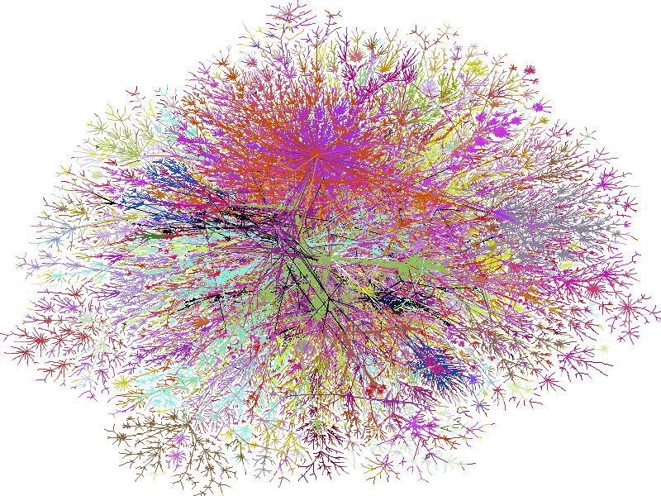
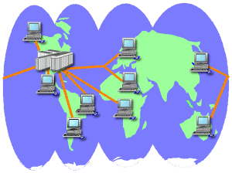
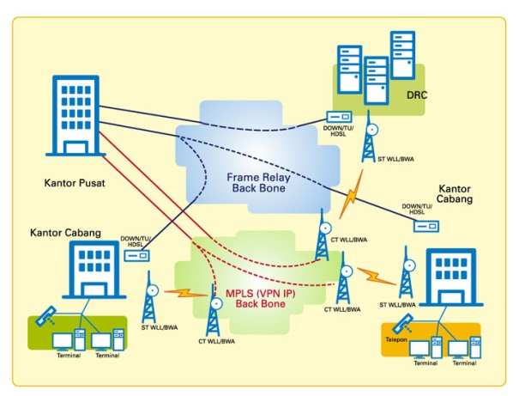
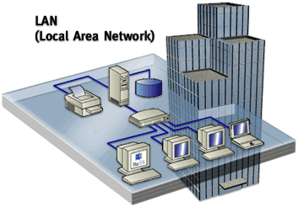


Type of network by area covered
Internet
WAN
Wide Area Network
MAN
Metropolitan Area Network
LAN
Local Area Network
PAN
Personal Area Network
BAN
Body Area Network

Slide 3
Wide Area Networks
WAN
Wide Area Network
Use local and long-distance telecommunications
Usually very high speed with low error rates
Usually follow a mesh topology

Slide 4
Network Mesh
A mesh is a network where all nodes can send, receive and relay data
A mesh is fully connected when all nodes are directly connected to all other nodes

Slide 5
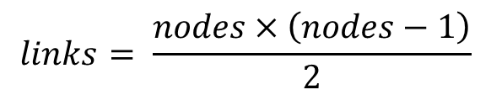
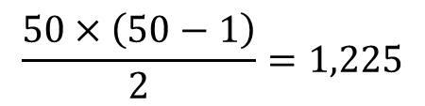
Fully connected Mesh
4 nodes, 6 links. Is that a problem?
8 nodes, 45 links. Is that a problem?
For fully connected network:
For 50 nodes,
links

Slide 6
Fully connected Mesh: exercises
6
nodes
9
and _____
links
If it were a fully connected mesh, it would have ____________________ links
(6 • 5)/2 =15
A network has 7 nodes. All nodes are connected with each other except for one node, which is connected to only one other node. How many links does the network have?
It’s a 6-node fully connected mesh with one extra node attached to it through one link. So, 15 + 1 = 16 links.

Slide 7
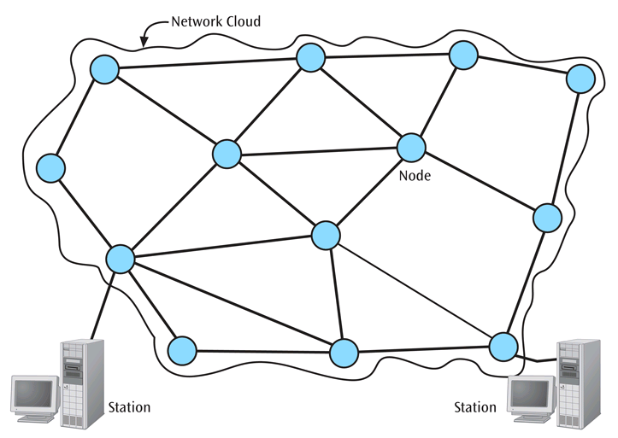
Network Mesh
A node is a device (computer,
router, …) that allows the transfer of information
A station is a device that interfaces a user to a network
The sub-network is the connection of nodes and telecommunication links. There are three types:
Message-switched
Circuit-switched
Packet-switched

Slide 8
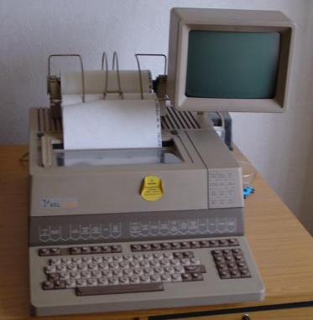
Sub-network: Types
Store-and-forward
Good for broadcasting
Today completely obsolete
Example: Telex
Message-switched
Circuit-switched
Packet-switched

Slide 9
Start sending first message
Intermediate
node 1
Intermediate
node 2
source
destination
transmission delay
message
Finish sending first message
propagation delay
processing
+ queuing delay
message
source
Intermediate
node 2
Intermediate
node 1
message
destination
Message-switched
Circuit-switched
Packet-switched

Slide 10
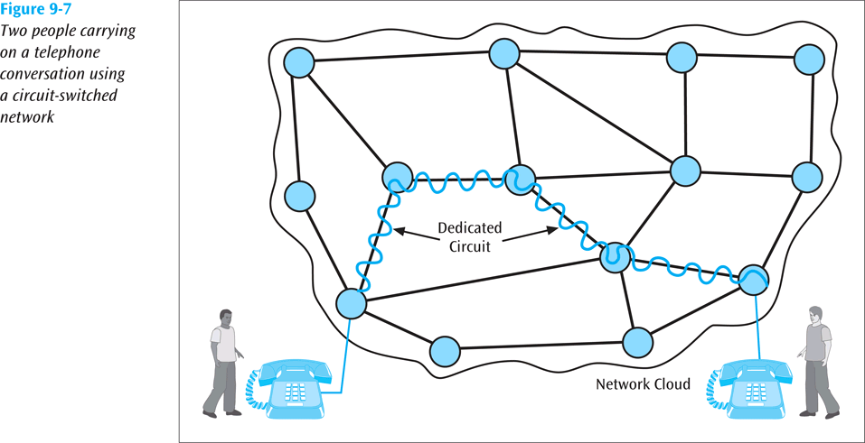
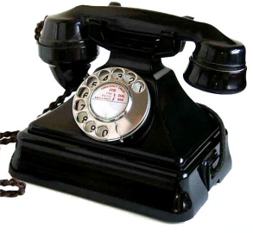
Sub-network: Types
A dedicated circuit (physical path) is established between sender and receiver and all data passes over this circuit.
The connection is dedicated until one party or another terminates the connection. Fixed Data Rate.
Today increasingly uncommon
Example: Telephone (PSTN)
Message-switched
Circuit-switched
Packet-switched

Slide 11
Intermediate
node 1
Intermediate
node 2
source
destination
call set up
searching for a connection
acknowledgement comes back
Data
Message-switched
Circuit-switched
Packet-switched

Slide 12
Circuit establishment
Information transfer
Control Signal
Sender
Data
node
node
node
node
node
Control signal
Receiver
Circuit disconnection
Message-switched
Circuit-switched
Packet-switched
Notes:
Circuit establishment –
end-to-end connection must be established
Information transfer
analogue voice, digitised voice or binary data
capacity across the network is dedicated for
even if no data is transferred
makes the network transparent to the users
no delays
Circuit disconnection
control signal to disconnect

Slide 13
Sub-network: Types
All data messages are transmitted using suitably sized packages, called packets.
Packets contain data and a header.
No unique dedicated physical path
example: Internet
Two types: Datagrams and Virtual Circuits
Internet
Message-switched
Circuit-switched
Packet-switched

Slide 14
source
Intermediate
node 1
Intermediate
node 2
transmission
delay
destination
PACKET 1
propagation
delay
processing
+ queuing delay
PACKET 2
PACKET 1
PACKET 3
PACKET 2
PACKET 1
PACKET 3
PACKET 2
PACKET 3
Message-switched
Circuit-switched
Packet-switched

Slide 15
Packet transfer delay = transmission + propagation + queuing + processing
Depends on packet length L (bits) and link bandwidth R (bits/s).
Transmission delay = L / R
Depends on congestion
Depends on speed of processor (for error-checking etc.)
Depends on length of physical link d (m) and propagation speed is medium s (m/s).
Propagation delay = d / s
If the queuing delay is 4 ms, the processing delay is 1 ms, the propagation delay is insignificant, and the link bandwidth is 8 Mbps, what is the total packet transfer delay for a 1,000-byte packet over one such link?
L = 1,000 bytes = 8•10³ bits
L / R = 10⁻³ s = 1 ms
R = 8 Mbps = 8•10⁶ bits/s
Packet transfer delay = transmission + propagation + queuing + processing
= 1 ms + 0 + 4 ms + 1 ms = 6 ms
Message-switched
Circuit-switched
Packet-switched

Slide 16
Packet-switching: Datagrams
Each packet carries extra overheads, e.g.
addresses (source and destination)
seq number etc.
Data 1
Data 2
Data 3
Datagrams
Message-switched
Circuit-switched
Packet-switched

Slide 17

Circuit Switching Vs. Packet Switching
CIRCUIT-Switched
PACKET-Switched
CALL SETUP REQUIRED
DEDICATED PHYSICAL PATH
PACKETS MAY FOLLOW DIFFERENT ROUTE
PACKETS ARRIVE ALWAYS IN ORDER
AVAILABLE BANDWIDTH IS FIXED
STORE AND FORWARD TRANSMISSION
CHARGED PER BYTE
CHARGED PER MINUTE
Notes:
Circuit
Advantages
charges are only for the connection time
favourable to those needing occasional short calls
cost effective when one device is communicating for long periods.
Disadvantages
circuit must first be set-up
time is relatively long (several seconds)
resulting circuit can only be used by the two connected computers
circuits can vary in quality
transmission rates are low - 9600 b/s to 33.6 Kb/s
can be inefficient - a line may stand idle for most of the connection time
many low speed links can be very expensive using circuit-switching.

Slide 18
Packet-switching: Virtual Circuit
Identifier (label)
Faster switching
No seq number required
Establishing the Circuit
Transferring information
Disconnecting the Circuit
Data 3
Data 2
Data 1
Control
sender
Control
receiver
Datagrams
Virt. Circuits
Message-switched
Circuit-switched
Packet-switched

Slide 19
Packet-switching: Virtual Circuit
Switched virtual circuit (SVC)
exists only for the duration of the data transfer
For each connection, a new circuit must be created
Permanent virtual circuits (PVC)
like leased lines, on a continuous basis
dedicated to specific user and no-one else can use it
no connection establishment or termination
user of a PVC will always get the same route
Datagrams
Virt. Circuits
Message-switched
Circuit-switched
Packet-switched

Slide 20
Circuit Switching Vs. Packet Switching
Circuit switching
setup delay
no other noticeable delays
Packet Switching
Virtual-circuit packet switching
setup delay
call acceptance response may experience delays
data packets are queued at each node
may experience delays - depending on load
Datagrams
no call setup
need to carry full address in each packet
Datagrams
Virt. Circuits
Message-switched
Circuit-switched
Packet-switched

Slide 21
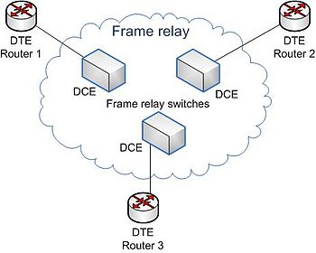
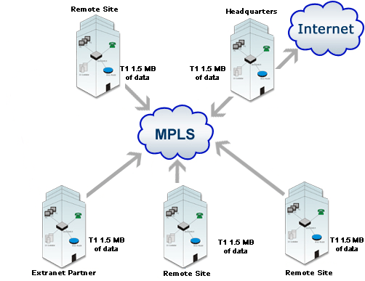
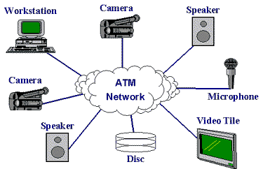
Examples of Wide Area Network protocols
Frame Relay
MPLS
ATM
Uses virtual circuit
No congestion because bandwidth is booked in advance
Guaranteed QoS
Uses admission control
Uses virtual circuit
Cell switching (similar to packet switching but uses fixed-sized 53-byte cells)
High speed and low delay thanks to the fixed cell sizes
Guaranteed QoS
Uses admission control
Uses virtual circuit
Designed for speed rather than reliability
Very simple and affordable
No special reservations

Slide 22

Examples of Wide Area Network protocols
ATM
ADMISSION CONTROL
Users negotiate with the network regarding the length of time, type of traffic, delay, bandwidth requirements etc.
If their request cannot be met, they are denied access
Uses virtual circuit
Cell switching (similar to packet switching but uses fixed-sized 53-byte cells)
High speed and low delay thanks to the fixed cell sizes
Guaranteed QoS
Uses admission control

Slide 23


Slide 24

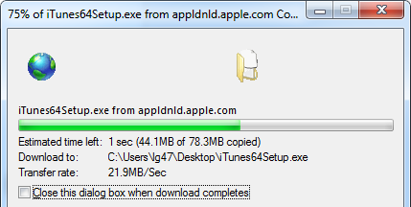
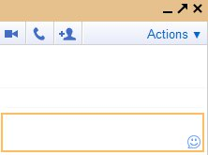
Types of traffic
Stream traffic - lengthy and continuous
Bursty traffic - short sporadic transmissions
Maria
Lin
Maria: Good morning Lin.
Good morning Lin.

Slide 25
Network Congestion
When a part of the network has so much traffic that individual packets are delayed noticeably
Can be caused by node and link failures; high amounts of traffic; improper network planning.
Severe congestion overflows buffers and causes packet losses

Slide 26
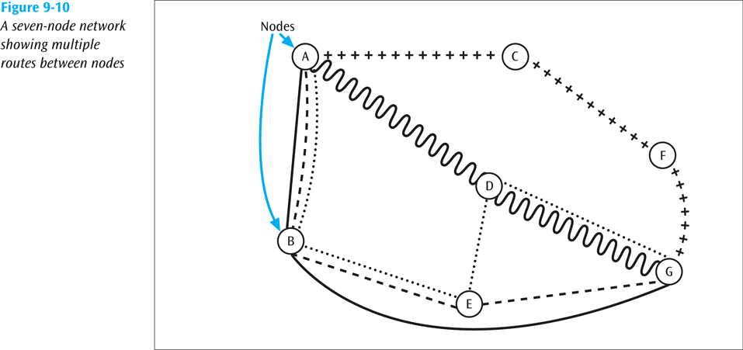
Routing
Each node in a WAN is a router. Multiple possible routes.
How does a router decide where to route?

Slide 27
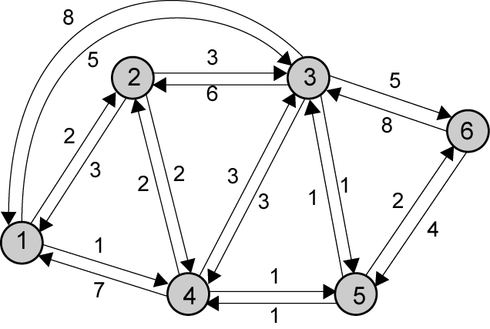
Routing
Every network is essentially a weighted graph of nodes and links
The links between nodes have associated costs, such as:
Delay
Number of hops
Bandwidth
Financial cost

Slide 28
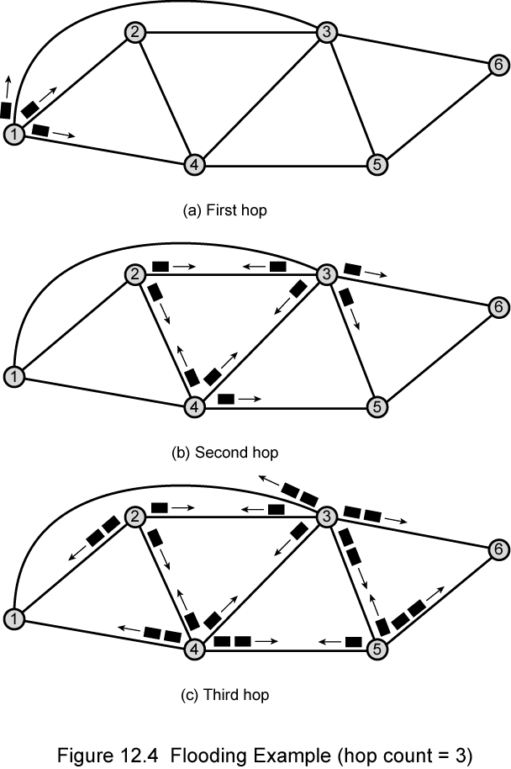
Routing: Flooding
Least intelligent, but useful sometimes
All possible routes are tried
All nodes are visited (useful to distribute information like routing)
At least one packet will take the minimum cost route (to be used for a virtual circuit)
To avoid overwhelming the network with “undead” packets
- Impose a hop limit (the number of times a packet can be copied)
and
- When a node receives a packet, it forwards it to its other neighbours, not the one it just receive it from

Slide 29
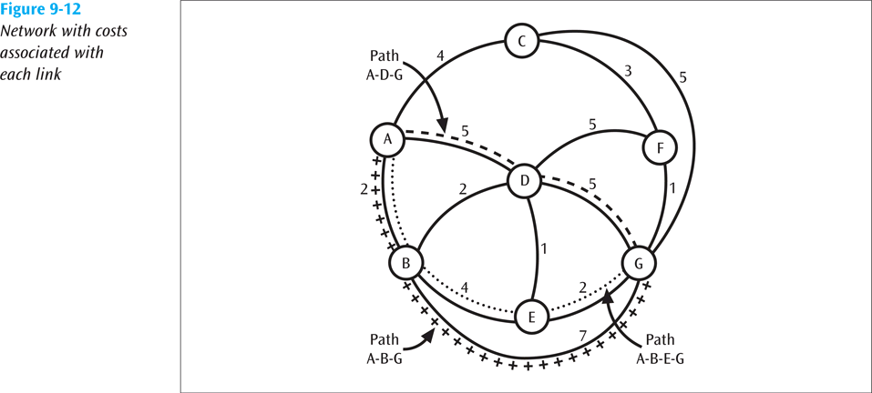
Dijkstra’s Least-Cost Algorithm
Finds all possible paths between two locations
Identifies the least-cost path
Finds shortest paths from given source node to all other nodes, by developing paths in order of increasing path length

Slide 30
Example of Dijkstra’s Algorithm
B
Must already know all individual link costs
7
ms
2
ms
A
3
ms
5
F
ms
C
7
ms
7
ms
1
2
ms
ms
D
G
E
3
ms
3
ms

Slide 31
Example of Dijkstra’s Algorithm
B (∞, -)
Set all distances to ∞
7
2
A
3
5
F (∞, -)
C (∞, -)
7
7
1
2
D (∞, -)
G (∞, -)
E (∞, -)
3
3

Slide 32
Example of Dijkstra’s Algorithm
B (7, A)
Examine nodes adjacent to A and update distances.
Identify the nearest node that is not permanent. This is now labelled as permanent.
7
2
A
3
5
F (∞, -)
C (3, A)
7
7
1
2
D (7, A)
G (∞, -)
E (∞, -)
3
3

Slide 33
Example of Dijkstra’s Algorithm
B (7, A)
Examine nodes adjacent to C that are not permanent and update distances.
Identify the nearest node that is not permanent. This is labelled as permanent.
7
2
A
3
5
F (8, C)
C (3, A)
7
7
1
2
D (5, C)
G (10,C)
E (∞, -)
3
3

Slide 34
Example of Dijkstra’s Algorithm
B (7, A)
Examine nodes adjacent to D that are not permanent and update distances.
Identify the nearest node that is not permanent. This is labelled as permanent.
7
2
A
3
5
F (8, C)
C (3, A)
7
7
1
2
D (5, C)
G (10,C)
E (8, D)
3
3

Slide 35
Example of Dijkstra’s Algorithm
B (7, A)
Examine nodes adjacent to B that are not permanent and update distances.
Identify the nearest node. This is labelled as permanent.
7
2
A
3
5
F (8, C)
C (3, A)
7
7
1
2
D (5, C)
G (10,C)
E (8, D)
3
3

Slide 36
Example of Dijkstra’s Algorithm
B (7, A)
Examine nodes adjacent to F that are not permanent and update distances.
Identify the nearest node. This is labelled as permanent.
7
2
A
3
5
F (8, C)
C (3, A)
7
7
1
2
D (5, C)
G (9,F)
E (8, D)
3
3

Slide 37
Example of Dijkstra’s Algorithm
B (7, A)
Examine nodes adjacent to E that are not permanent and update distances.
Identify the nearest node that is not permanent. This is labelled as permanent.
7
2
A
3
5
F (8, C)
C (3, A)
7
7
1
2
D (5, C)
G (9,F)
E (8, D)
3
3

Slide 38
2nd Example of Dijkstra’s Algorithm
5
4
B
Must already know all individual link costs
7
A
2
3
F
3
C
2
7
4
3
11
2
4
D
G
E
3
3
2

Slide 39
2nd Example of Dijkstra’s Algorithm
5
4
B (∞, -)
Set all distances to ∞
7
A (∞, -)
2
3
F
3
C (∞, -)
2
7
4
3
11
2
4
D (∞, -)
G (∞, -)
E (∞, -)
3
3
2

Slide 40
2nd Example of Dijkstra’s Algorithm
5
4
B (4, F)
Examine nodes adjacent to F and update distances.
Identify the nearest node that is not permanent. This is labelled as permanent.
7
A (∞, -)
2
3
F
3
C (∞, -)
2
7
4
3
11
2
4
D (∞, -)
G (3, F)
E (∞, -)
3
3
2

Slide 41
2nd Example of Dijkstra’s Algorithm
5
4
B (4, F)
Examine nodes adjacent to G that are not permanent and update distances.
Identify the nearest node that is not permanent. This is labelled as permanent.
7
A (∞, -)
2
3
F
3
C (∞, -)
2
7
4
3
11
2
4
D (∞, -)
G (3, F)
E (5, G)
3
3
2

Slide 42
2nd Example of Dijkstra’s Algorithm
5
4
B (4, F)
Examine nodes adjacent to B that are not permanent and update distances.
Identify the nearest node that is not permanent. This is labelled as permanent.
7
A (11, B)
2
3
F
3
C (∞, -)
2
7
4
3
11
2
4
D (∞, -)
G (3, F)
E (5, G)
3
3
2

Slide 43
2nd Example of Dijkstra’s Algorithm
5
4
B (4, F)
Examine nodes adjacent to E that are not permanent and update distances.
Identify the nearest node that is not permanent. This is labelled as permanent.
7
A (11, F)
2
3
F
3
C (7, E)
2
7
4
3
11
2
4
D (8, E)
G (3, F)
E (5, G)
3
3
2

Slide 44
2nd Example of Dijkstra’s Algorithm
5
4
B (4, F)
Examine nodes adjacent to C that are not permanent and update distances.
Identify the nearest node that is not permanent. This is labelled as permanent.
7
A (11, F)
2
3
F
3
C (7, E)
2
7
4
3
11
2
4
D (8, E)
G (3, F)
E (5, G)
3
3
2

Slide 45
2nd Example of Dijkstra’s Algorithm
5
4
B (4, F)
Examine nodes adjacent to D that are not permanent and update distances.
Identify the nearest node that is not permanent. This is labelled as permanent.
7
A(10, D)
2
3
F
3
C (7, E)
2
7
4
3
11
2
4
D (8, E)
G (3, F)
E (5, G)
3
3
2

Slide 46
2nd Example of Dijkstra’s Algorithm
5
4
B (4, F)
F
→ G
→ E
→ D
→ A = 10
7
A(10, D)
2
F
→ B = 4
3
F
→ G
→ E
→ C = 7
F
3
F
→ G
→ E
→ D = 8
C (7, E)
2
7
F
→ G
→ E = 8
4
3
F
→ G = 3
11
2
4
D (8, E)
G (3, F)
E (5, G)
3
3
2

Slide 47
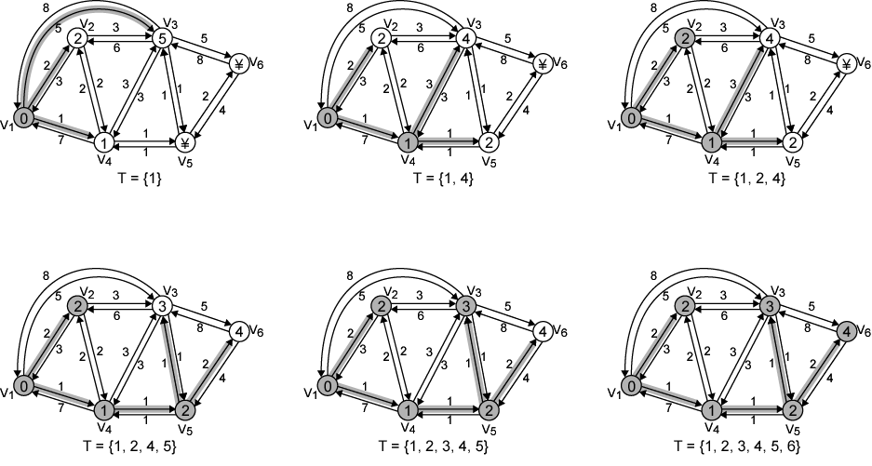
Homework: Another example of Dijkstra’s Algorithm

Slide 48
Homework: Another example of Dijkstra’s Algorithm - Results
Iteration | T | L(2) | Path | L(3) | Path | L(4) | Path | L(5) | Path | L(6) | Path
1 | {1} | 2 | 1–2 | 5 | 1-3 | 1 | 1–4 | ∞ | - | ∞ | -
2 | {1,4} | 2 | 1–2 | 4 | 1-4-3 | 1 | 1–4 | 2 | 1-4–5 | ∞ | -
3 | {1, 2, 4} | 2 | 1–2 | 4 | 1-4-3 | 1 | 1–4 | 2 | 1-4–5 | ∞ | -
4 | {1, 2, 4, 5} | 2 | 1–2 | 3 | 1-4-5–3 | 1 | 1–4 | 2 | 1-4–5 | 4 | 1-4-5–6
5 | {1, 2, 3, 4, 5} | 2 | 1–2 | 3 | 1-4-5–3 | 1 | 1–4 | 2 | 1-4–5 | 4 | 1-4-5–6
6 | {1, 2, 3, 4, 5, 6} | 2 | 1-2 | 3 | 1-4-5-3 | 1 | 1-4 | 2 | 1-4–5 | 4 | 1-4-5-6

Slide 49
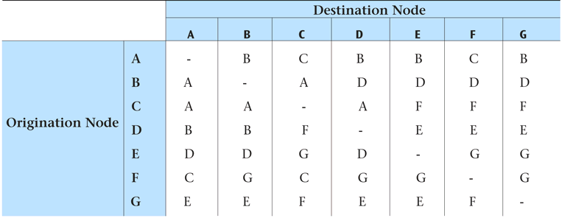
Centralised Routing
One routing table is kept at a “central” node
When a node needs a routing decision, it asks the central node
The central node must be able to handle large number of routing requests
Notes:
With adaptive routing, routing tables can change to reflect changes in the network
Static routing does not allow the routing tables to change.
Static routing is simpler but does not adapt to network congestion or failures.

Slide 50
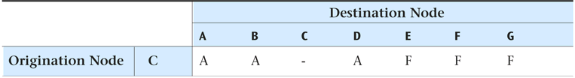
Distributed Routing
Each node maintains its own routing table
No central node holding a global table
Somehow each node has to share information with other nodes so that the individual routing tables can be created
Individual routing tables may hold outdate information

